Slide 1
Engineering Graphics Lab
Introduction and
Practice Sheet

Slide 2

Equipment
Lettering
Dimensioning
Dimensioning Components
Dimensioning Methods
Arrow head
Practice Sheet
What will we learn ?

Slide 3
Sr. No. | Name of the Drafting Equipment | Use
1. | Drawing Board | It is used to place & hold the drawing sheet properly. It is also used to support T — Square & Mini draughter.
2. | Mini Draughter | It is used to draw parallel lines & lines at any angle.
3. | Set Squares | They are used for drawing all straight lines except horizontal lines.
4. | Protractor | It is used to draw or to measure angles, which cannot be draw with the set squares.
5. | Compass | It is used for drawing circles and arcs of circles.

Slide 4
Sr. No. | Name of the Drafting Equipment | Use
6. | Divider | They are used to divide straight line into desired number of parts & to transfer the dimensions from one part of the drawing to another part
7. | Drawing Sheet | It is available in standard size as specified in BIS as follows.
 | Designation | Size (mm)
 | A0 | 1189×841
 | A1 | 841×594
 | A2 | 594×420
 | A3 | 420×297
 | A4 | 297×210
 | A5 | 210×148 .

Slide 5
Sr. No. | Name of the Drafting Equipment | Use
8. | French Curves | It is used to draw curves, which cannot be drawn by compass.
9. | Drawing Pencils | Different grades of pencils are available to draw different line.
 | Grades of Pencils | Use
 | H | Visible Outlines, Lettering, Cutting Plane Line
 | 2H | Dimension line, Extension line, Leader line, Hatching line, Centre line

Slide 6
Sr. No. | Name of the Drafting Equipment | Use
10. | Eraser | It is used for erasing the pencil lines & it should not spoil the surface of sheet.
11. | Duster | It is used to clean drawing sheet & instruments.
12. | Adhesive Tapes, Clips | They are used to hold the drawing sheet properly.

Slide 7
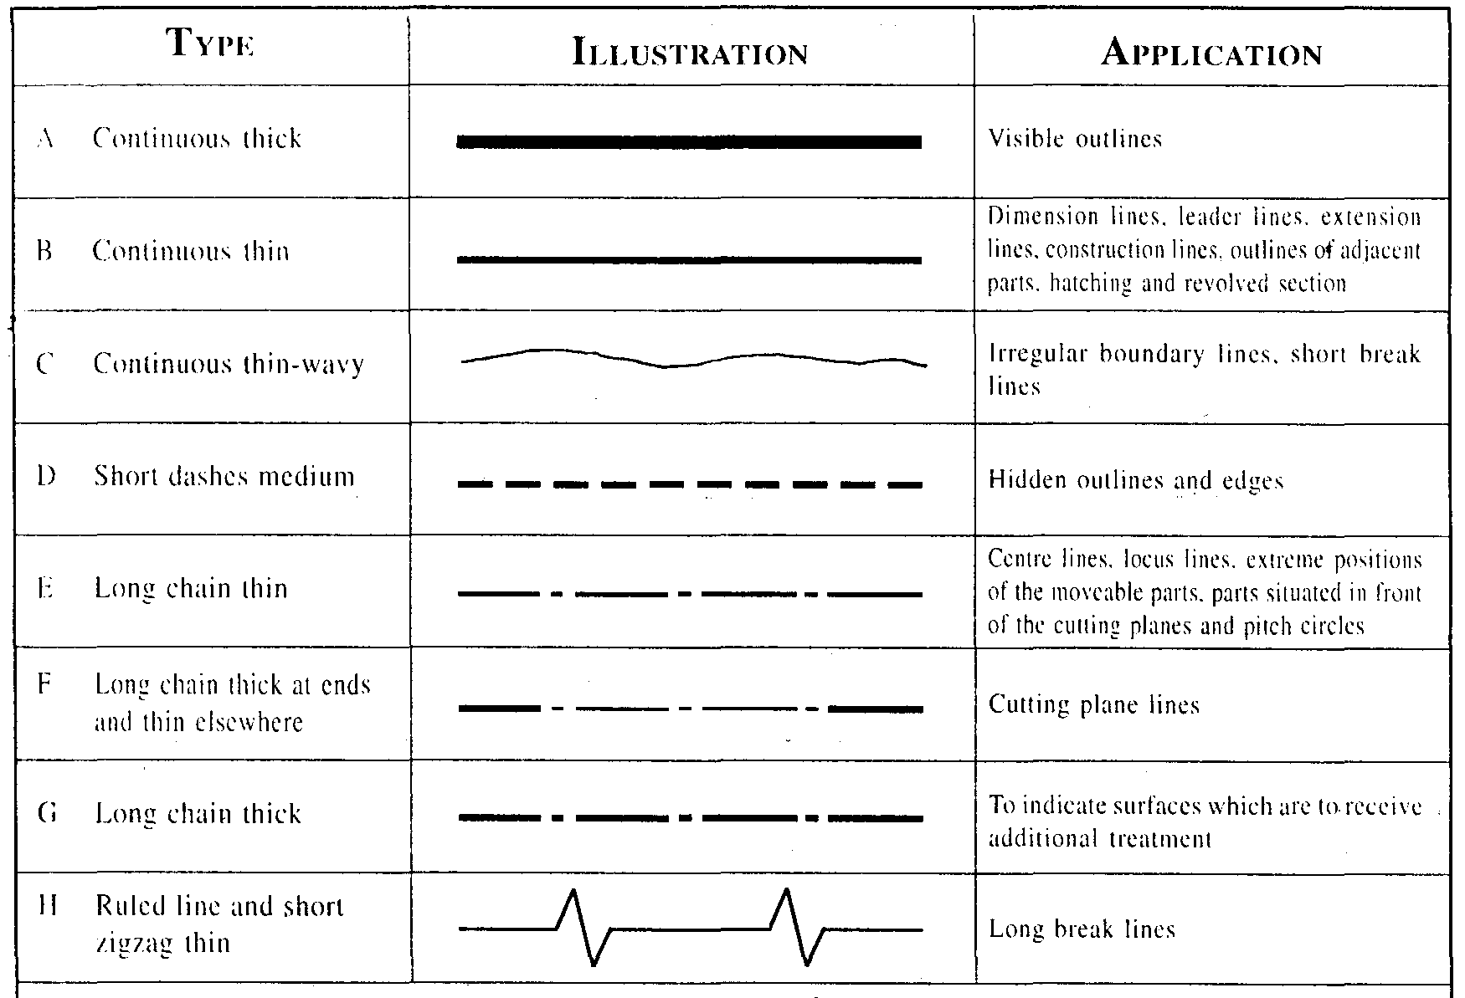

Slide 8
Lettering
Writing of titles, dimensions, notes and other important particulars on a drawing is called lettering. It is an important part of a drawing.
However accurate and neat a drawing may be draw. Its appearance is spoiled and sometimes, its usefulness is impaired by poor lettering.
Lettering should, therefore, be done properly in clear, legible and uniform style. It should be in plain and simple style so that it could be done freehand and speedily.

Slide 9
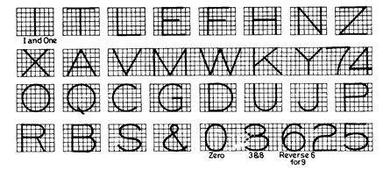
Lettering

Slide 10
Dimensioning
• Dimensioning is necessary in order to convey a clear and definite size description of an object. Manufacturer of component or object must know the exact length, width and height of a piece, diameters of shaft and holes and their locations.
• Dimension line, extension line, arrow heads and dimension figure are the elements of any dimension.
• Two recommended styles of dimensioning are Aligned system and unidirectional system of dimensioning.

Slide 11
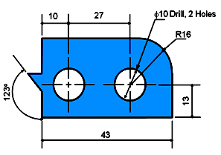
Dimensioning Components
1. Extension lines
2. Dimension lines with arrowheads
3. Leader lines
4. Dimension figures
5. Notes :
  - Local note
  - General note
6. Arrow Head

Slide 12
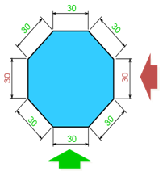
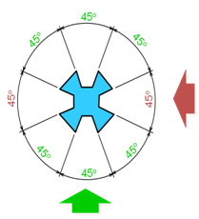
Dimensioning Methods
1. Aligned method
The dimension figures are placed so that they are readable from the bottom and right side of the drawing.

Slide 13
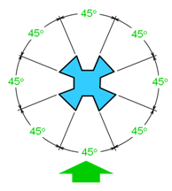
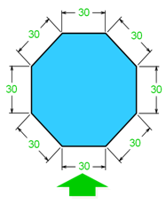
Dimensioning Methods
2. Unidirectional method
The dimension figures are placed so that they can be read from the bottom of the drawing.

Slide 14
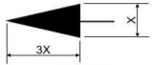
Arrow head
Arrowheads are used as terminators on dimension lines.
The points of the arrowheads on leader lines and dimension lines must make contact with the feature object line or extension lines which represent the feature being dimensioned.
The standard size ratio for all arrowheads on mechanical drawings is 3:1 (length to width).

Slide 15
Practice Sheet : Problem 1
Write in block letters in mentioned height of lettering:
10 mm: “I LOVE MY INDIA”

Slide 16
Practice Sheet : Problem 1
Write in block letters in mentioned height of lettering:
10 mm: “I LOVE MY INDIA”
10

Slide 17
Practice Sheet : Problem 1
Write in block letters in mentioned height of lettering:
10 mm: “I LOVE MY INDIA”
I LOVE MY INDIA
10

Slide 18
Practice Sheet : Problem 2
Construct regular polygon of 30 mm side.
(Pentagon & Hexagon)

Slide 20
A
B
30

Slide 21
P
30
A
B
30

Slide 22
P
A
B

Slide 23
P
A
B

Slide 24
P
M
A
B

Slide 25
P
M
A
B

Slide 26
P
M
A
B

Slide 27
P
6
4
M
A
B

Slide 28
P
6
5
4
M
A
B

Slide 29
P
6
5
4
M
A
B

Slide 30
P
6
5
4
M
A
B

Slide 31
D
E
P
C
6
5
4
M
A
B

Slide 32
D
E
P
C
6
5
4
M
A
B

Slide 33
D
E
P
C
6
5
4
M
A
B

Slide 34
D
E
P
C
6
5
4
M
A
B

Slide 35
D
E
P
C
6
5
4
M
A
B

Slide 36
D
E
P
C
6
5
4
M
A
B

Slide 37
D
E
P
C
6
5
4
M
A
B

Slide 38
H
G
D
E
P
C
6
I
F
5
4
M
A
B

Slide 39
H
G
D
E
P
C
6
I
F
5
4
M
A
B

Slide 40
H
G
D
E
P
C
6
I
F
5
4
M
A
B

Slide 41
H
G
D
E
P
C
6
I
F
5
4
M
A
B

Slide 42
H
G
D
E
P
C
6
I
F
5
4
M
A
B

Slide 43
H
G
D
E
P
C
6
I
F
5
4
M
A
B

Slide 44
Practice Sheet : Problem 3
Exercise on use of drawing instruments

Slide 45
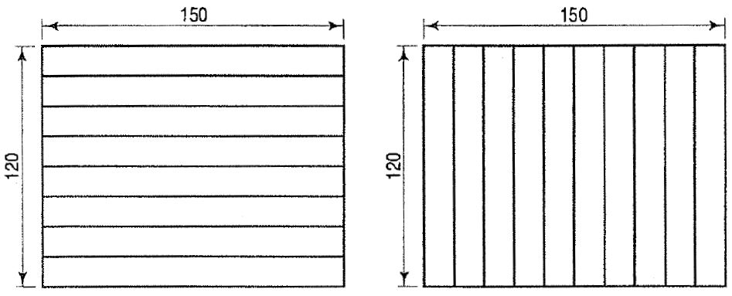
Practice Sheet : Problem 3
(Space between two lines is 10mm)

Slide 46
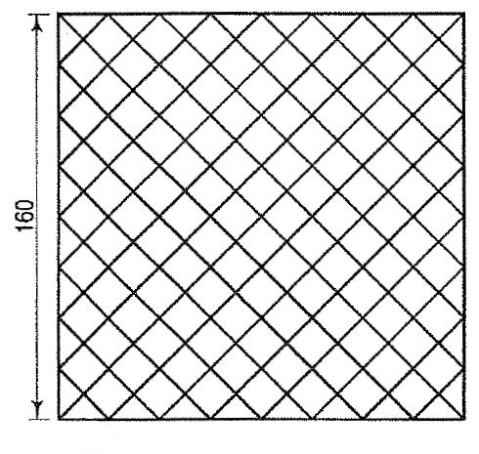
Practice Sheet : Problem 3
Square of 160mm X 160mm
45⁰
(Space between two lines is 10mm)

